Slide 1
E-Commerce Portal

Slide 2
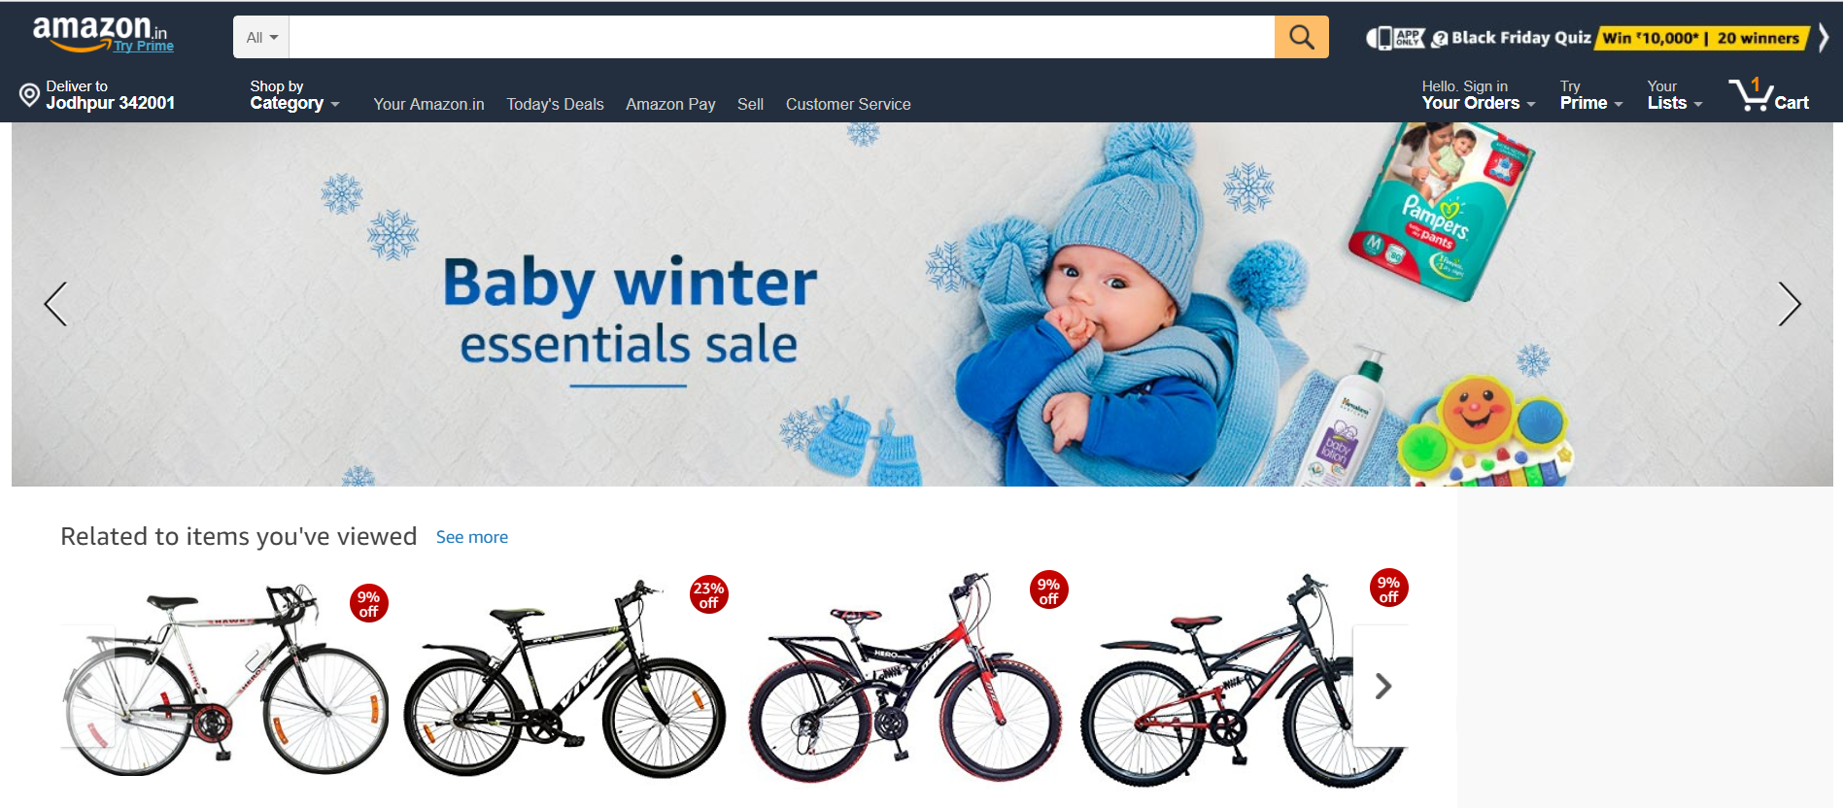
Expectation

Slide 3
VS

Slide 4
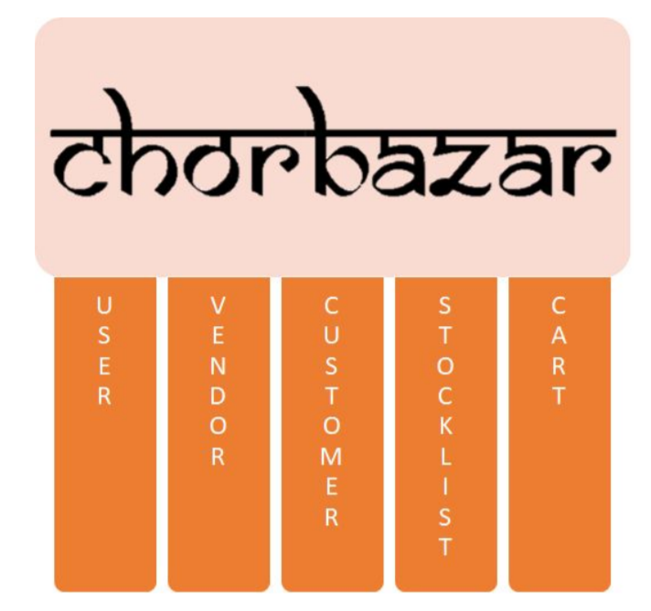
Reality

Slide 5

OBJECTIVES
To develop an e-commerce application for an online retailer.
To provide a user friendly interface for virtual shopping, wherein the customers can choose to purchase a variety of products available.

Slide 6
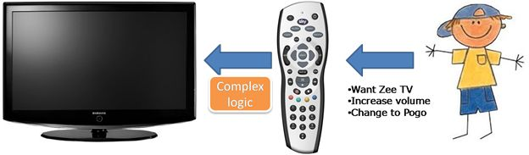
CONCEPTS USED
ABSTRACTION
.ie. Displaying only essential information and hiding the details.
Example:

Slide 7
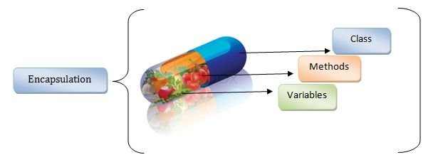
CONCEPTS USED
ENCAPSULATION
Encapsulation is defined as wrapping up of data and information under a single unit.
Example:

Slide 8

CONCEPTS USED
INHERITANCE
The process by which objects of one class acquire the properties of objects of another class.
Example:

Slide 9
INHERITANCE USAGE
CUSTOMER CLASS
USER CLASS
VENDOR CLASS

Slide 10
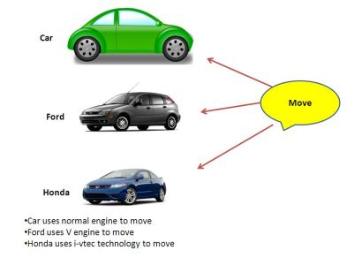
CONCEPTS USED
POLYMORPHISM
Ability to take more than one form.
Example:

Slide 11
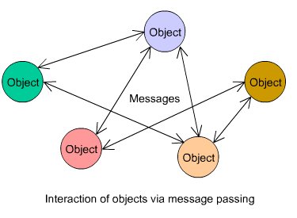
CONCEPTS USED
OBJECT-ORIENTED MESSAGING
message passing sends a message to a process (which may be an actor or object) and relies on the process and the supporting infrastructure to select and invoke the actual code to run.
Example:

Slide 12
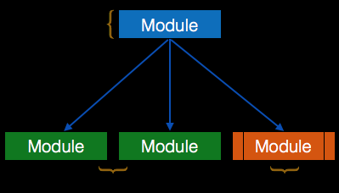
CONCEPTS USED
MODULARITY
separating the functionality of a program into independent, interchangeable modules
Example:

Slide 13
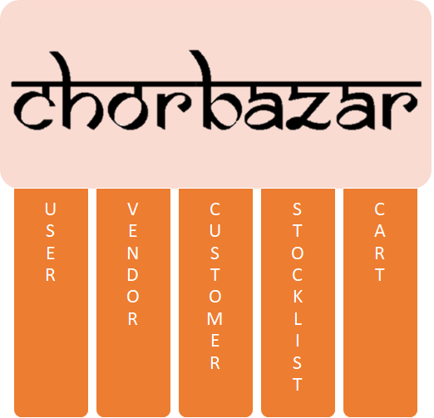
The 5 main pillars

Slide 14
LOGICAL FLOW

Slide 15
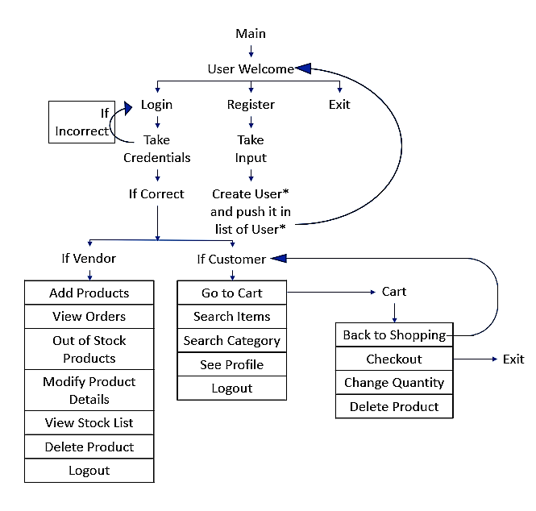

Slide 16
CODE EXECUTION

Slide 17
CLASS DIAGRAM

Slide 18
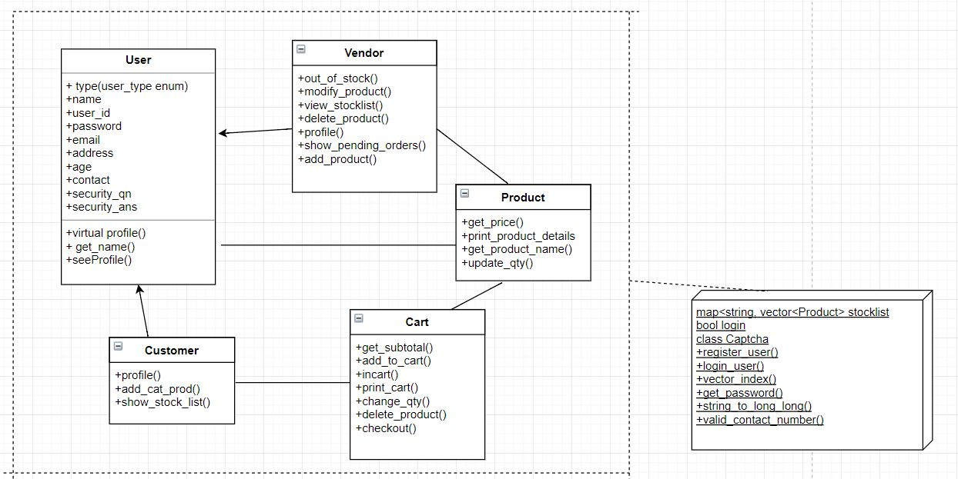

Slide 19
WHY SECURITY ?
Password is your first line of defense.
Passwords ensure the security and confidentiality of data stored.
Did you know that you could be legally arrested for any damage
caused
An easy-to-guess password or leaving your account logged in can allow your colleagues to misuse your account.

Slide 20
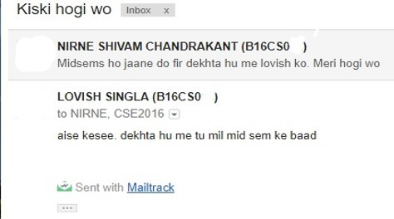
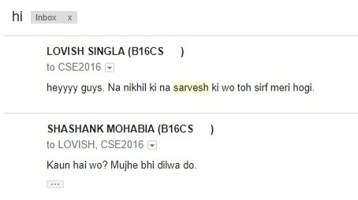
WHY SECURITY ?
#include<sarcasm.h> using namespace CSE2016;

Slide 21
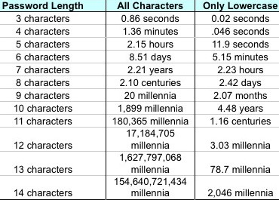
Password strength (brute force)
http://cache.gawkerassets.com/assets/images/17/2010/03/500x_password_hacking_times-1.jpg

Slide 22
USER CLASS

Slide 23
The User Class
Contains the functionalities of registering a new user and logging in a
user after proper verification
Class which is inherited by Customer and Vendor.
Contains the attributes (like name, user id, etc) common to all users.
.i.e. Customers and Vendors

Slide 24
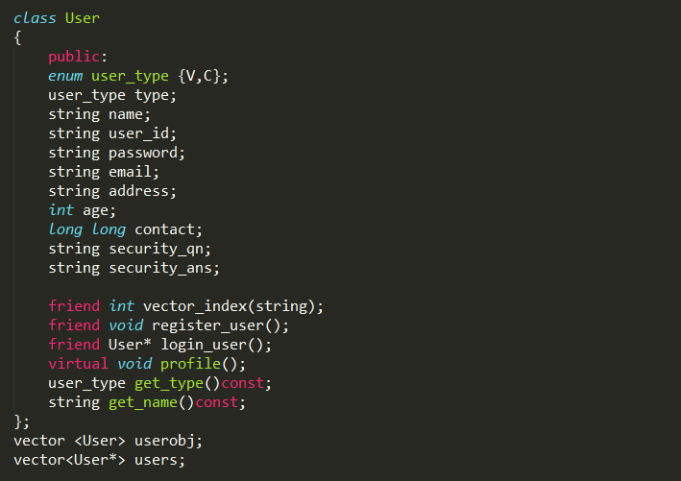
Implementation

Slide 25
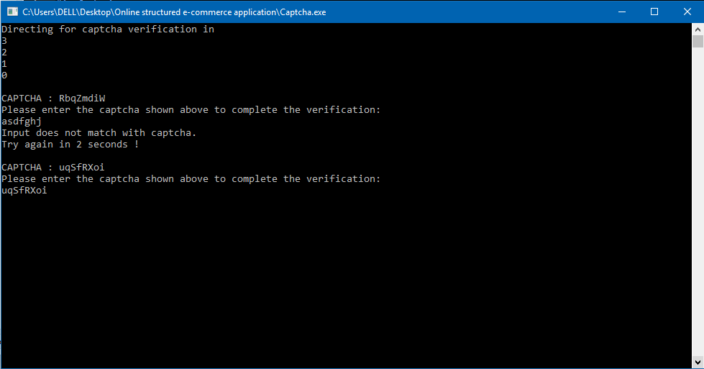
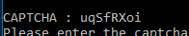
The Ace of Spades -Class Captcha

Slide 26
HIGHLIGHTS

Slide 27
Use of map<string, vector <Product> > for stocklist
The use of such a data structure helps us store data in the form of category, list of product tuples which is easier and faster to traverse.
Using vector <Product *> instead of vector<Product>
Currently used in Cart and Customer
Use of Random Generator to generate Captcha()
The use of a random generator to generate random numbers and produce a captcha of fixed length requires srand() which seeds the timestamps to generate the outputs.
Virtual function profile
The use of profile function as virtual helps in reduction of code as we can store the pointers to Customer class and Vendor class under a vector of User pointer objects. Helps in reducing code redundancy.

Slide 28
SCOPE FOR VERSION 2.0

Slide 29
Search Optimization
There are several techniques for search optimization, but the one which hit us is the use of Longest Common Subsequence to find the closest match to an input string. For this a simple LCS code needs to be written and wherever the operator == was called for 2 string comparisons, it can be overloaded to call LCS which returns LCS between given string and the input set.
Suggestions/Related Products
The solution to this problem can be converted to a graph based algorithm where all the products can be assumed to be nodes/vertices of a complete graph. The edge weights between 2 vertices represents the number of Customers who have purchased both the products.

Slide 30
File Handling/Database
The problem of reinitialising the Users and Products as soon as the code is restarted can be frustrating. The use of simple file handling can however resolve this issue. The structures can be copied as it is into a binary or a text file and can be refreshed at the end of the program
execution.
Graphical User Interface(GUI)
Due to obvious reasons the aesthetics of the code are hindered due to the “Black and white “ terminal window which is plain and boring to look at. The use of the header graphics.h can however make the current code look more interesting.
Trending Products
A max heap containing all the products in terms of number of items can be stored. This heap can return the maximum element in constant time of operation.

Slide 31
Reference counting
The problem of multiple vendors selling the same product can be resolved by using reference counting since we are already using a vector<Product *> instead of vector<Product>. An additional counter of number of pointers pointing to Product can be stored in the Product class and then it can be checked appropriately while deleting objects(if count>1 do nothing else delete and call destructor)

Slide 32

Thanks!

